Slide 1
Delay in the Web Audio API

Slide 2
The DelayNode
Simply passes input audio to output, after some specified delay time
Example: delay node with 5ms delay
myNode = new DelayNode(context,{delayTime:0.005})
Or
myNode = context.createDelay()
delayTime: amount of delay in seconds
maxDelayTime: maximum delay time (rarely needed)
Delay is simple but its uses are very powerful
Comb filter
Feedback delay
Vibrato
Karplus-Strong algorithm

Slide 3
Comb filter
Just sums input signal with a delayed version of that input.
For input signal x[n] and delay of D, output is just
y[n]=x[n]+x[n-D]
Magnitude response is 0 at f=1/(2D), 3 /(2D), 5 /(2D),…
for D = 1 millisecond
notches in the response occur at 500 Hz, 1500 Hz, 2500 Hz, …
known as comb filter, since when plotted with linear frequency, notches resemble the teeth of a comb as used for your hair

Slide 4
Comb filter code
<button onclick='context.resume()'>Play</button>
<p>Frequency</p>
<input type='number' id='Frequency' min=50 max=4000 value=440 step='any'>
<p>Delay</p>
<input type='number' id='Delay' min=0.001 max=0.01 value=0.005 step=0.001>
<script>
var context = new AudioContext()
let tone = new OscillatorNode(context,{frequency:440})
let delay= new DelayNode(context,{delayTime:0.005})
tone.start()
tone.connect(delay)
tone.connect(context.destination)
delay.connect(context.destination)
Delay.oninput = ()=> delay.delayTime.value = Delay.value
Frequency.oninput = ()=> tone.frequency.value = Frequency.value
</script>
send both source & delayed copy of that source to destination

Slide 5
Feedback delay
input
delay
output
feedback
gain
Delayed signal gets attenuated and fed back into the delay
Signal gets repeated over and over, each time with less amplitude
Lots of variations
Add original to feedback signal → dry/wet mix
Send output of feedback gain to output

Slide 6
Feedback Delay
var context = new AudioContext()
let tone = new OscillatorNode(context,{frequency:2000})
tone.start()
toneGain = new GainNode(context,{gain:0})
var delay= new DelayNode(context,{delayTime:0.08})
var feedback= new GainNode(context,{gain:0.8})
tone.connect(toneGain)
toneGain.connect(delay)
delay.connect(feedback)
feedback.connect(delay)
delay.connect(context.destination)
Delay.oninput = ()=> delay.delayTime.value = Delay.value
Gain.oninput = ()=> feedback.gain.value = Gain.value
Play.onclick = ()=> {
context.resume()
let now = context.currentTime
toneGain.gain.setValueAtTime(1, now)
toneGain.gain.linearRampToValueAtTime(0, now + 0.05)
}
</script>
Use the delay node to create delay with feedback
tone
toneGain
delay
destination
feedback
<input type='button' value='play' id='Play'>
<p>Gain</p>
<input type='range' min=0.5 max=0.99 value=0.8 step='any' id='Gain'>
<p>Delay (ms)</p>
<input type='range' min=0 max=0.2 value=0.08 step='any' id='Delay'>
<script>
…
</script>

Slide 7
Karplus-Strong algorithm

Slide 8
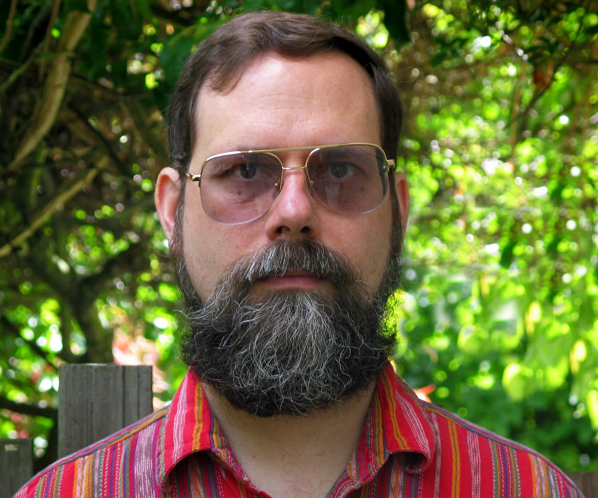
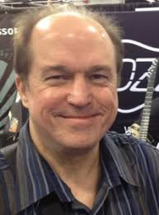
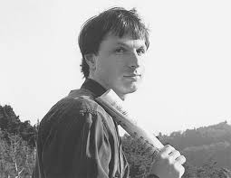
Karplus-Strong synthesis
Early form of physical modelling synthesis
David Jaffe played violin in a string quartet
“violist was Alex Strong, who I didn't know. We just started talking and he was kind of a technical computer science-y kind of guy. I said something about how I was trying to synthesize guitars and he said, ‘Oh, you know, we just discovered this really great way of synthesizing guitars and I'd love to show it to you, but you have to sign a nondisclosure.’ And I said, ‘Okay, I'd love to do that.’
Karplus, Kevin; Strong, Alex (1983). "Digital Synthesis of Plucked String and Drum Timbres". Computer Music Journal. 7 (2): 43–55.
Jaffe, David A.; Smith, Julius O. (1983). "Extensions of the Karplus-Strong Plucked String Algorithm" Computer Music Journal. 7 (2): 56–69.
Strong invented the algorithm
Karplus analysed it
Jaffe tried to make it more musical
Smith showed how it modelled a vibrating string
Kevin Karplus
David Jaffe Julius Smith
Notes:
The Karplus-Strong algorithm is an early form of physical modelling synthesis, invented by Alex Strong, first analysed by Kevin Karplus, and then extended by David Jaffe and Julius O. Smith. As described by David Jaffe, he was playing violin in a string quartet and, ““violist was Alex Strong, who I didn't know. We just started talking and he was kind of a technical computer science-y kind of guy. I said something about how I was trying to synthesize guitars and he said, ‘Oh, you know, we just discovered this really great way of synthesizing guitars and I'd love to show it to you, but you have to sign a nondisclosure.’ And I said, ‘Okay, I'd love to do that.’”

Slide 9
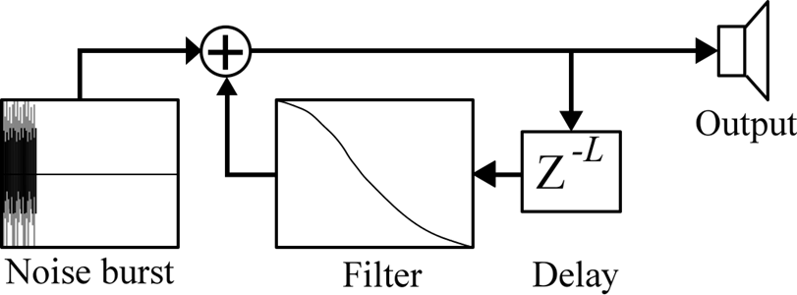
How it works
loops short waveform through filtered delay line
Short excitation waveform (length L samples), typically white noise, is generated
Excitation is output and simultaneously fed back into delay line L samples long
delay line acts to store one period of the signal
Output of delay line fed through a filter.
Filter gain must be less than 1 at all frequencies, to maintain stable positive feedback loop.
Filter typically a low order, lowpass filter
Filter characteristics mainly determine harmonic structure of decaying tone.
Filtered output simultaneously mixed back into the output and fed back into the delay line

Slide 10
Tuning the string
Fundamental frequency should be f0=fs/L, where L is the number of units of delay
Period T0=L/fs
L= fs*D, where D is the delay time
X(z)
Y(z)
X(z)+gZ^{-L}Y(z)
Y(z)=X(z)+gZ^{-L}Y(z)
H(z)=1/(1- gZ^{-L})
gZ^{-L}Y(z)
Z^{-L}Y(z)

Slide 11
Audio graph for simple implementation of Karplus-Strong algorithm
Noise
Noise
Gain
+
destination
Feedback
Gain
Delay

Slide 12
Web audio implementation
Automatically adds one block delay in implementation in a feedback loop
x ms delay is actually x ms+128/f_{s}
F_{s} is the sample rate
Only when delay is connected in a feedback loop of nodes
This holds even with a worklet
So highest frequency is fs/128 (~344.5 for 44.1kHz)
Solution: implement the feedback loop inside an audio worklet

